Slide 1
IBM University Engagement Project Submission
“Exploring the Power of Agentic AI with IBM Granite and IBM Bob”

Slide 2

Project Tile – ArogyaAI - AI Health & Nutrition Assistant
Domain of Project – Healthcare & Wellness (AI Health & Nutrition Assistant)
Student Name | Recent Passport Photo | Email ID | Mobile number [WhatsApp]
Vedant Vijay Khedekar |  | vedantkhedekar37@gmail.com | 9321618309

Slide 3
Problem Statement -
Problem Statement : ArogyaAI
The Challenge
People struggle with diet planning, portion control, and tracking nutritional intake. Reliable, personalized, real-time guidance is often missing, leading to poor food choices.
The Objective
Build ArogyaAI that delivers personalized dietary insights and guidance for individuals and families. It should:
Personalized Diet Plans – Based on age, health, allergies, and goals.
Food Data RAG Retrieval – Calories, macros, and vitamins from trusted sources.
Diet Tracking & Feedback – Log meals via text, image, or voice for instant analysis.
Preventive Health Focus – Diabetes-friendly, heart-healthy diet suggestions.
Multi-Agent System –
Nutrition Knowledge Agent ·
Diet Recommendation Agent ·
Health Advisory Agent ·
Food Log & Feedback Agent
Visualization Dashboard – Weekly nutrient intake and progress tracking.
Health Utilities – BMI, calories, water intake, and exercise tips.
Scoped, Safe Guidance – Stays within health topics, explains reports without diagnosing, always with a disclaimer.

Slide 4
Proposed Solution -
Proposed Solution: ArogyaAI – AI Health & Nutrition Assistant
The proposed solution is a multi-agent AI-powered Health & Nutrition Assistant called ArogyaAI built using IBM watsonx.ai and Granite Models for personalized, real-time dietary guidance.
At its core, the solution uses Retrieval-Augmented Generation (RAG) to fetch trusted data (USDA, WHO) and summarize calories, macros, and vitamins.
The system consists of four key agents:
Nutrition Knowledge Agent – nutrition data.
Diet Recommendation Agent – meal plans.
Health Advisory Agent – preventive advice.
Food Log & Feedback Agent – meal logging & feedback.
The solution includes a user-friendly dashboard that visualizes nutrient intake, deficiencies, and progress.
Watsonx.ai orchestrates workflows and governance; Granite models power reasoning and personalization.
Overall, this solution delivers an end-to-end intelligent nutrition assistant for healthier lifestyles.

Slide 5
Technology Used
IBM Grainte model (ibm-granite-3-2-8b) – language understanding & personalization
IBM Cloud – Infrastructure to build, deploy, and scale a reliable, scalable environment for ArogyaAI.
RAG – fetch real data first, then generate intelligent answers for more trustworthy results.
IBM Watsonx.ai - For model deployment, embeddings, and AI governance
Vector Database (FAISS/Chroma) – nutritional data retrieval
IBM BOB- For Frontend and Backend

Slide 6
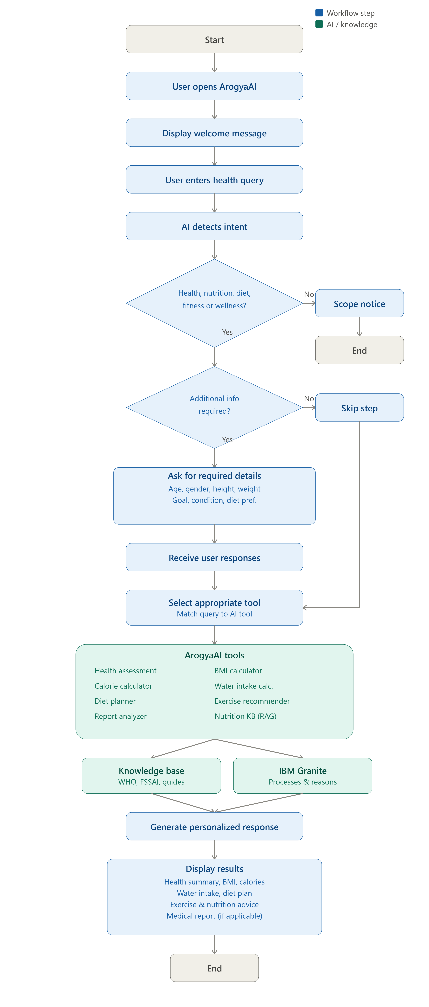
Architecture blueprint

Slide 7

Role of Agentic AI in the solution
Role of Agentic AI in ArogyaAI
Agentic AI lets ArogyaAI act as an autonomous system, not just a chatbot, using IBM watsonx.ai and IBM Granite models to coordinate specialized agents.
Each agent handles one role—data, plans, advice, or logs—collaboratively. This multi-agent approach ensures accurate results.
It also brings context awareness for tailored recommendations, plus real-time adaptation from daily inputs.
Agents also communicate with each other for better decisions.
Overall, it makes ArogyaAI a smart digital nutritionist.

Slide 8
Novelty and Uniqueness
The proposed ArogyaAI stands out by combining Agentic AI, RAG, and personalization into a single intelligent system.
Multi-Agent Intelligence – Specialized agents collaborate for accurate guidance.
RAG-Based Accuracy – Real-time retrieval reduces misinformation.
Hyper-Personalization – Plans tailored to health, culture, and goals.
Real-Time Feedback Loop – Adapts from daily logs and behavior.
Multi-Modal Input – Text, voice, or image-based tracking.
Preventive Healthcare Focus – Disease-specific nutrition advice.
Scalable & Enterprise-Ready – Built on IBM watsonx.ai with IBM Granite models for reliability & governance.
This makes the solution a smart, adaptive, and proactive digital nutritionist.

Slide 9
Git Hub Link
Github URL –https://github.com/vedantkhedekar37-eng/IBM-Project
·
·
·

Slide 10
Future Scope
1.Integration with Wearables & Health Devices –
Sync with smartwatches and fitness trackers for real-time activity and health data, enabling more accurate recommendations.
2.AI-Powered Voice Assistant & Multilingual Support –
Add voice interaction and multilingual support for wider accessibility and inclusivity.

Slide 11
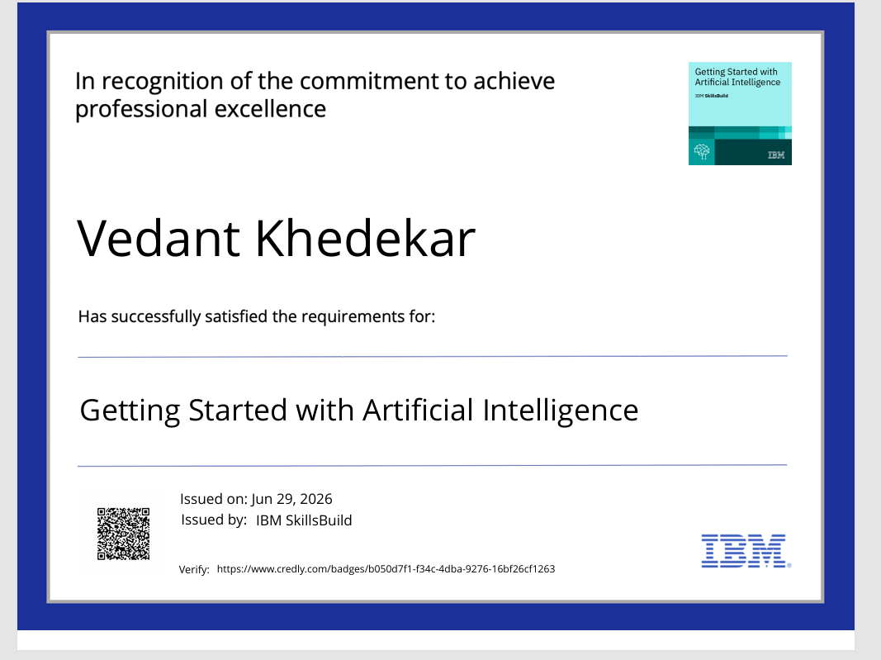
Certificates Earned:
Please add your credly certificate

Slide 12
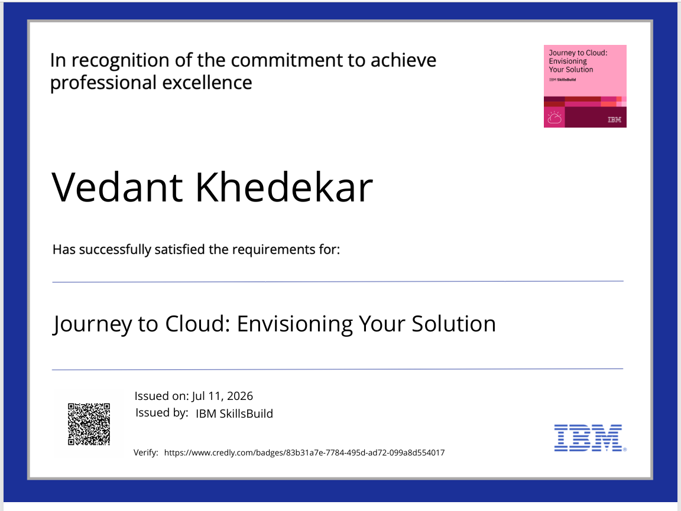

Slide 13
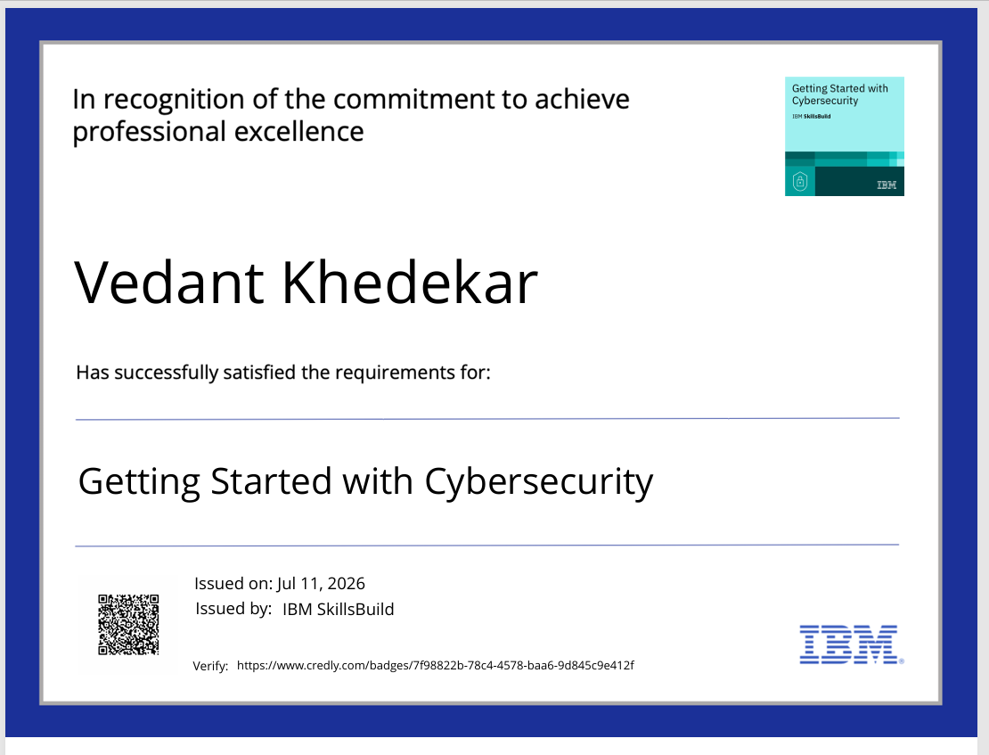

Slide 14
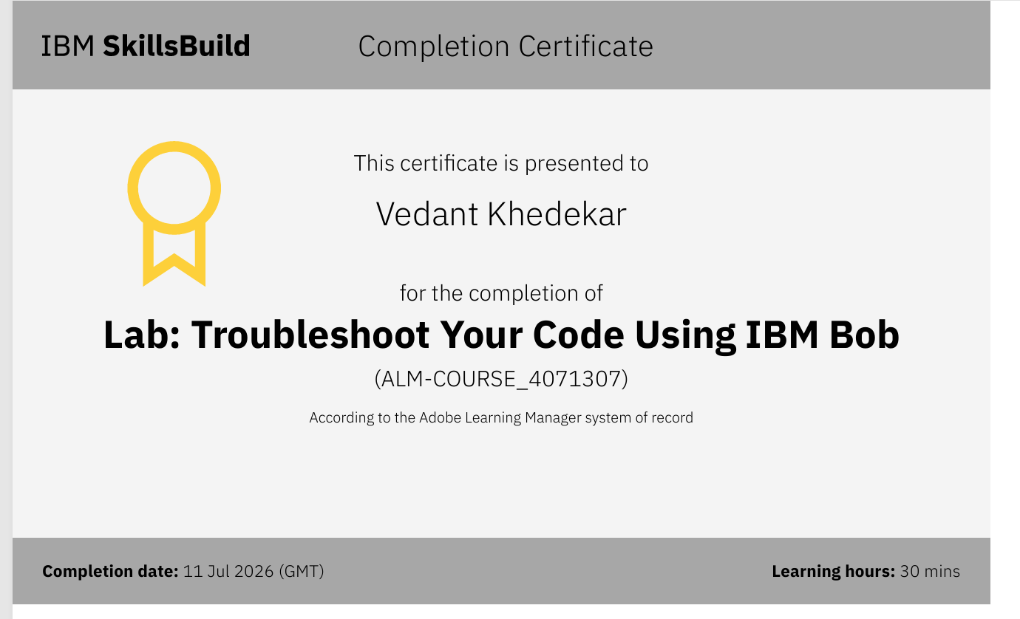
Certificates Earned:​
Add your IBM BOB Certificate

Slide 15
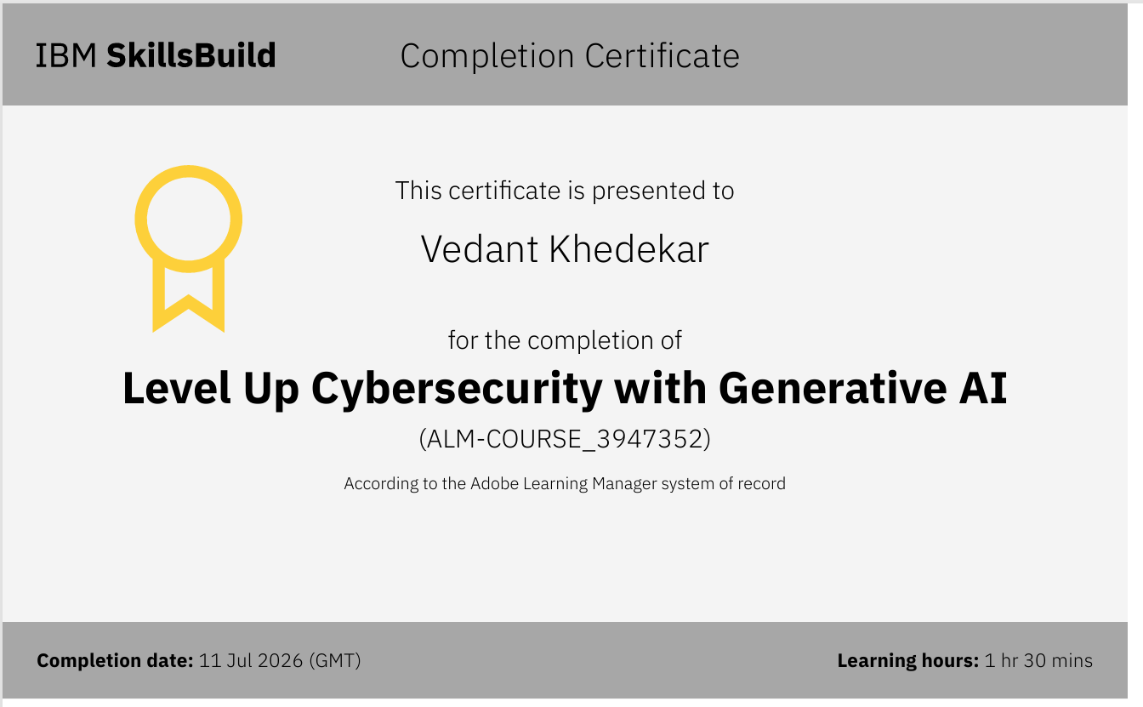

Slide 16
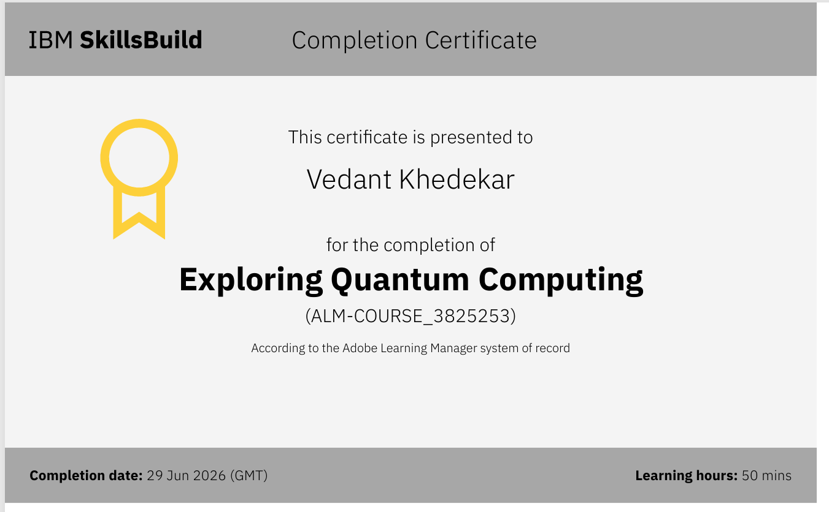

Slide 17


